Slide 1
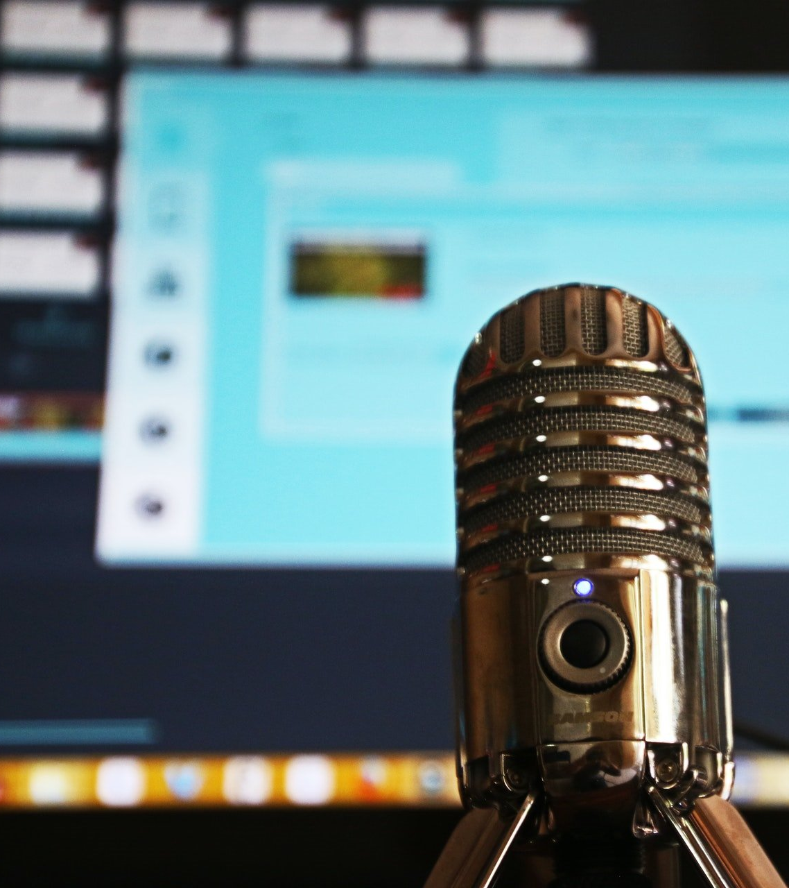


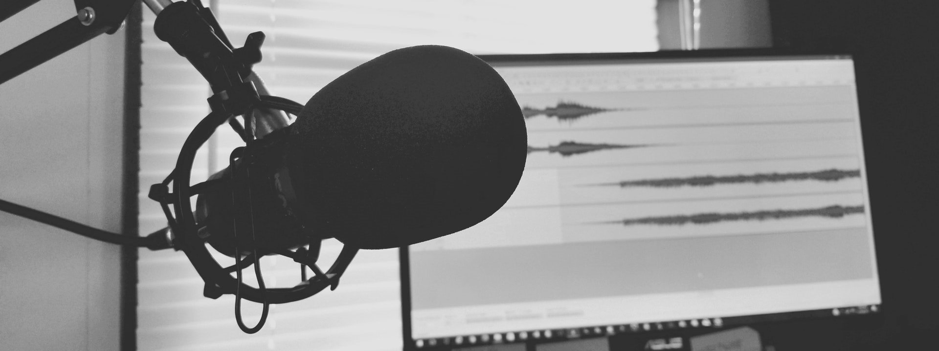
Pandemic Podcasting -
It's good to talk…

Slide 2

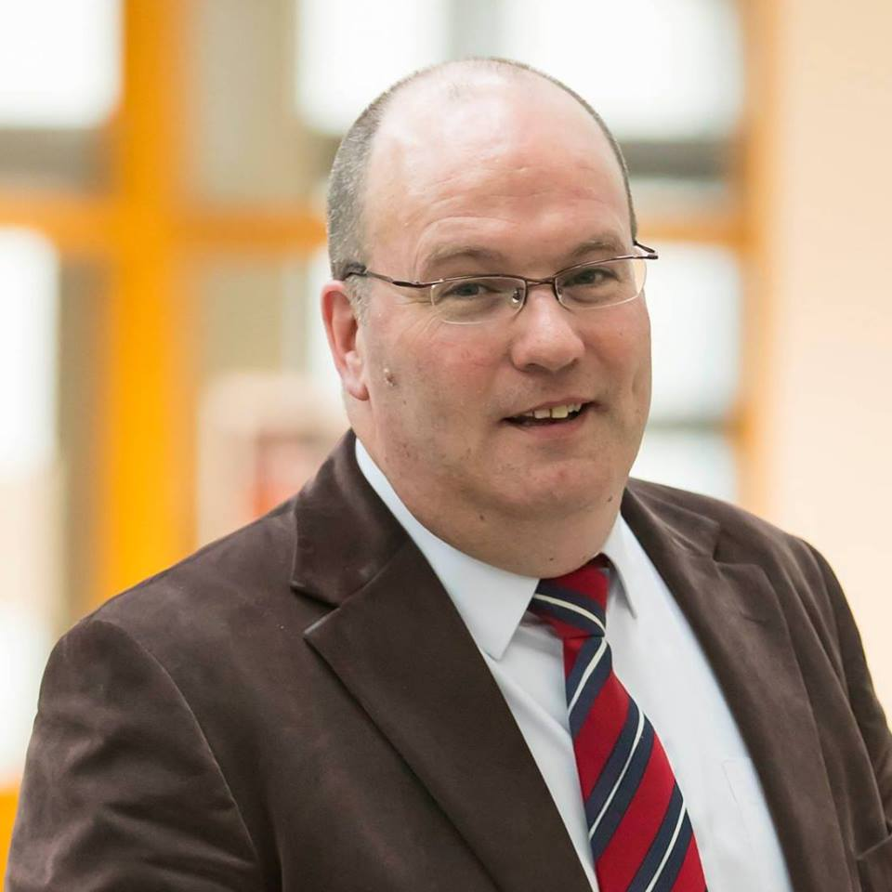


EdTech Winter Conference 2021
Pandemic Podcasting
It’s good to talk…
Ken McCarthy
kmmccarthy@wit.ie
Twitter: @kenmccarthy7
LinkedIn: https://www.linkedin.com/in/kenmccarthy/
Personal Website: https://kenmccarthy.ie
Slides: https://kenmccarthy.ie/edtech21

Slide 3

Background
Avid Podcast Listener
Rich Conversational Format
Thought about starting EdTech Podcast
But it was never the right time
And I never had the right
Tools / Guests / Talent etc. etc.
COVID-19
#GastaGoesGlobal
Just needed to use the name Who's Zoomin' Who?
Pandemic Podcasting
It’s good to talk…

Slide 4
Format
One to One Online Zoom Call
Usually around about 30 minutes
Unscripted but with some prompts and preliminary discussion
Little or no post-production or editing
  Time Constraints
  Capability
Pandemic Podcasting
It’s good to talk…

Slide 5
Tools
Zoom (https://zoom.us/)
Screencast-O-Matic (https://screencast-o-matic.com/)
PowerPoint
  Intro titles
Anchor.fm (https://anchor.fm/)
  Syndicated to all major podcast platforms
YouTube (https://www.youtube.com/)
Twitter, LinkedIn, Facebook
Personal Website (https://kenmccarthy.ie/)
Pandemic Podcasting
It’s good to talk…

Slide 6
The Guests
Ep 01 – Tom Farrelly, IT Tralee
Ep 02 – Colm Dunphy, WIT
Ep 03 – Orna Farrell, DCU
Ep 04 – Sharon Flynn, IUA
Ep 05 – Marie O’Neill, CCT College
Ep 06 – Oisin Hassan, NStEP
Ep 07 – Catherine Cronin, National Forum
Pandemic Podcasting
It’s good to talk…

Slide 7
The Guests
Ep 08 – Gearóid Ó Súilleabháin, CIT
Ep 09 – Brian Mulligan, IT Sligo
Ep 10 – Carina Ginty, GMIT
Ep 11 – Tom O'Mara, UCC
Ep 12 – Eamon Costello, DCU
Ep 13 – Lorraine Gallagher & Trevor Boland, AHEAD
Ep 14 – Mark Brown, DCU
Pandemic Podcasting
It’s good to talk…

Slide 8
Reaction
Guests seemed to like it
Featured on the DCU archive of COVID-19 Resources
Regularly attracted over 100 listeners per episode
Lots of positive feedback
Shared stories and experiences
A sense of community in a time of crisis
We were not in this alone
Reconnected with some old friends
Made some new ones!
Pandemic Podcasting
It’s good to talk…

Slide 9
Lessons
There is a power in doing
Perfection is a myth
Good enough is good enough
People like to talk, people are incredibly generous with their time
The 14 episodes that were recorded have and will become and oral history of the EdTech response to the COVID-19 pandemic
Carpe Diem - seize the day!
Pandemic Podcasting
It’s good to talk…

Slide 10
Next Steps
Start recording new episodes
Watch this space
Lots of Guests lined up
But the old gremlin of trying to find
the “Right Time” is getting in the way again!
Pandemic Podcasting
It’s good to talk…

Slide 11
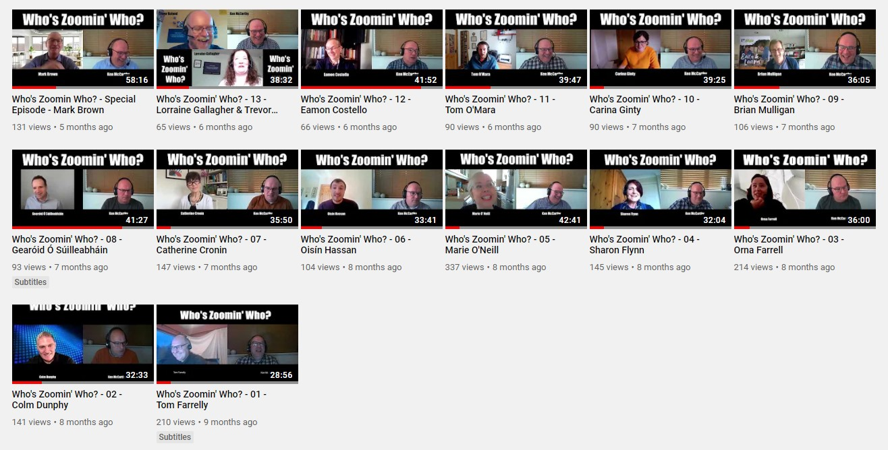
YouTube
Pandemic Podcasting
It’s good to talk…

Slide 12
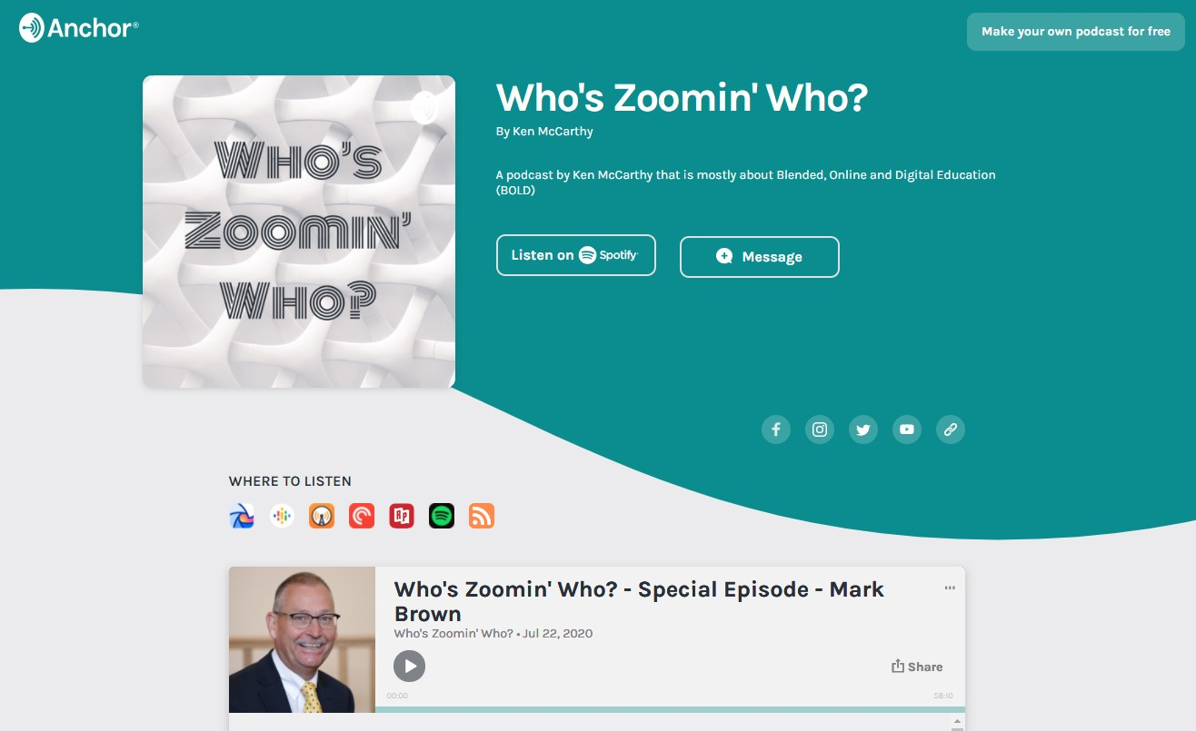
Anchor.fm
Pandemic Podcasting
It’s good to talk…

Slide 13

Thank You
and thanks Tom!
Pandemic Podcasting
It’s good to talk…

